Slide 1

Milestone 6: Monitoring
Software Engineering
for AI Enabled Systems
Students: Basile Andrea, Iacovazzi Antonio Raffaele, Lorusso Roberto

Slide 2
Agenda
Monitoring at Resource Level
Prometheus
Grafana
Better-Uptime
Locust
Monitoring at Performance Level
Alibi-detector

Slide 3
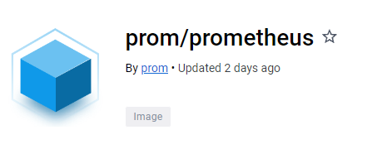
Prometheus-setup
dockerfile
FROM prom/prometheus
COPY prometheus.yml /etc/prometheus/prometheus.yml
> docker pull prom/prometheus: latest
prometheus.yml
global:
scrape_interval: 15s
scrape_timeout: 60s
scrape_configs:
- job_name: 'fastapi'
scrape_interval: 15s
scrape_timeout: 60s
static_configs:
- targets: ['docker.for.mac.localhost:9100']

Slide 4

Grafana-setup
> docker pull grafana/grafana-oss: latest
Grafana OSS (Open Source Software) is the open-source version of Grafana, while Grafana is also available in a paid version called Grafana Enterprise. The Enterprise version offers some additional features compared to the OSS version, such as support for enterprise authentication and integration with other business intelligence tools. In general, Grafana OSS is used by organizations that want a advanced monitoring solution but do not need the features offered by the Enterprise version.

Slide 5
Connect Prometheus & Grafana
Once the docker images have been downloaded, it is possible to modify the docker-compose.yaml
...
prometheus:
container_name: prometheus_container
ports:
- '9300:9090'
build:
context: ./prom
dockerfile: Dockerfile
networks:
- prometheus_grafana
depends_on:
- backend ...
...
grafana:
container_name: grafana_container
image: grafana/grafana-oss
ports:
- '3000:3000'
networks:
- prometheus_grafana
depends_on:
- prometheus
networks:
prometheus_grafana:
The network “Prometheus_Grafana” is addes in order to let the two container to communicate each other.

Slide 6
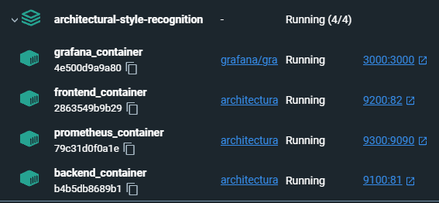
Connect Prometheus & Grafana
Once the docker images have been downloaded, it is possible to modify the docker-compose.yaml
The network “Prometheus_Grafana” is addes in order to let the two container to communicate each other.

Slide 7
Prometheus Metrics
REQUEST_TIME = Gauge(
"request_processing_seconds",
"Time spent processing request",
["method", "endpoint"],
)
AVG_DDFC = Gauge(
"avg_ddfc",
"Average of last 5 'delay detection following change' of the drift detector."
)
hist_img = Histogram(
"img_size",
"Histogram for tracking the size of the images",
buckets=[100,200,300,400,500,600,700,800,900,1000]
)
counter_predictions = Counter(
"counter_predictions",
"Counter for predictions that have been made",
)
counter_labeled_images = Counter(
"counter_labeled_images",
"Counter for images sent to extend the dataset",
)
counter_feedback = Counter(
"counter_feedback",
"Counter for feedbacks sent by the experts",
)

Slide 8
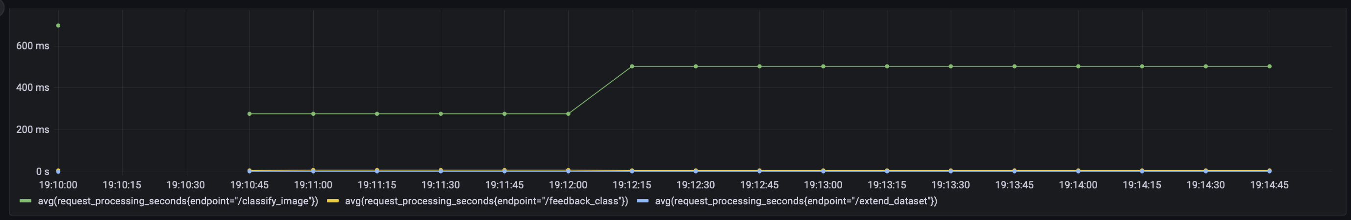
Grafana dashboard
PromQL queries for data visualization
avg(request_processing_seconds{endpoint="/classify_image"})
avg(request_processing_seconds{endpoint="/extend_dataset"})
avg(request_processing_seconds{endpoint="/feedback_class"})

Slide 9
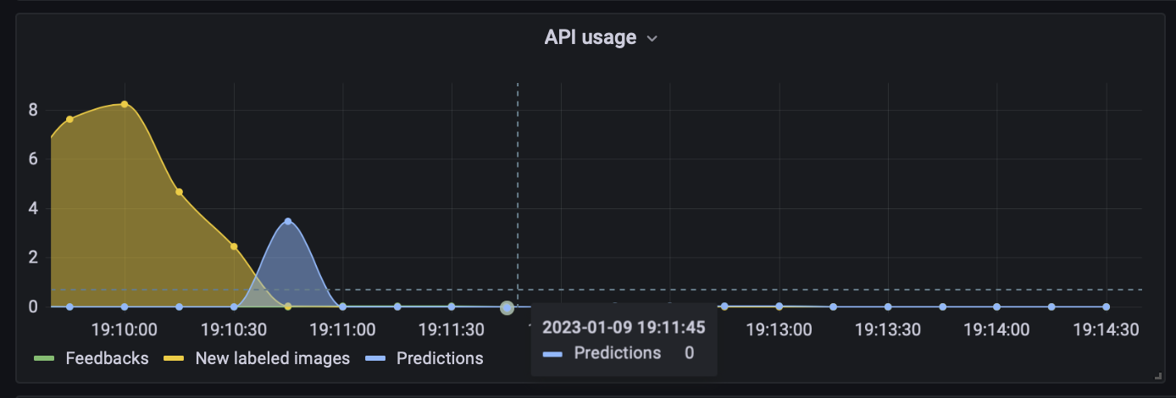
Grafana dashboard
PromQL queries for data visualization
rate(counter_feedback_total[1m])

Slide 10
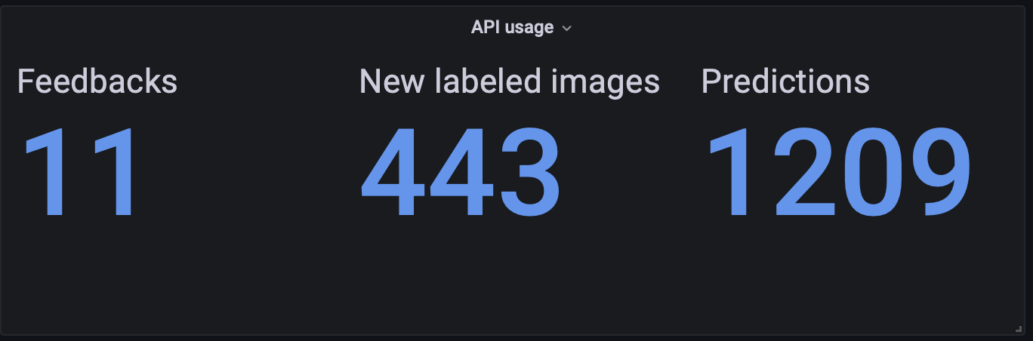
Grafana dashboard
PromQL queries for data visualization
counter_feedback_total

Slide 11
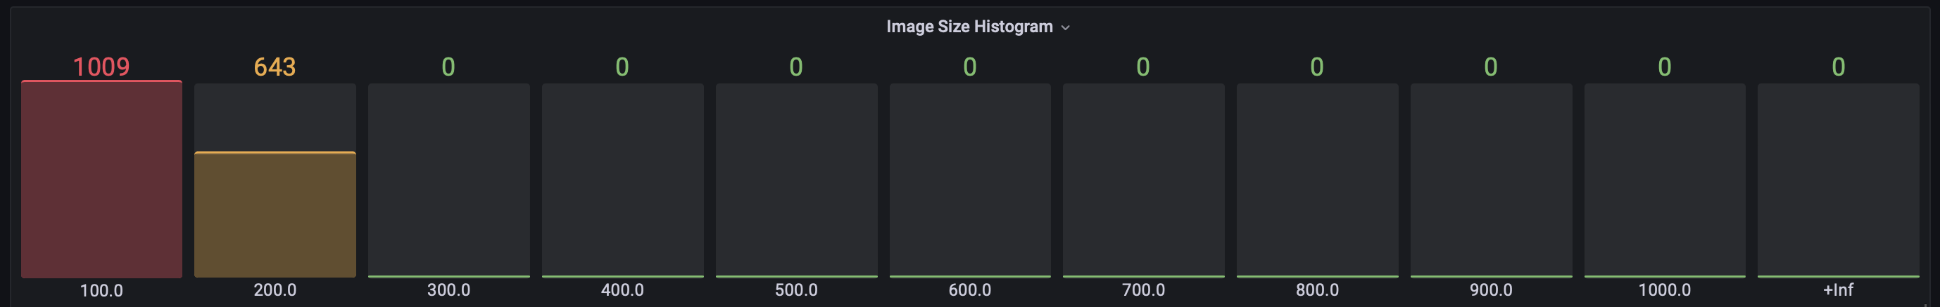
Grafana dashboard
PromQL queries for data visualization
img_size_bucket

Slide 12
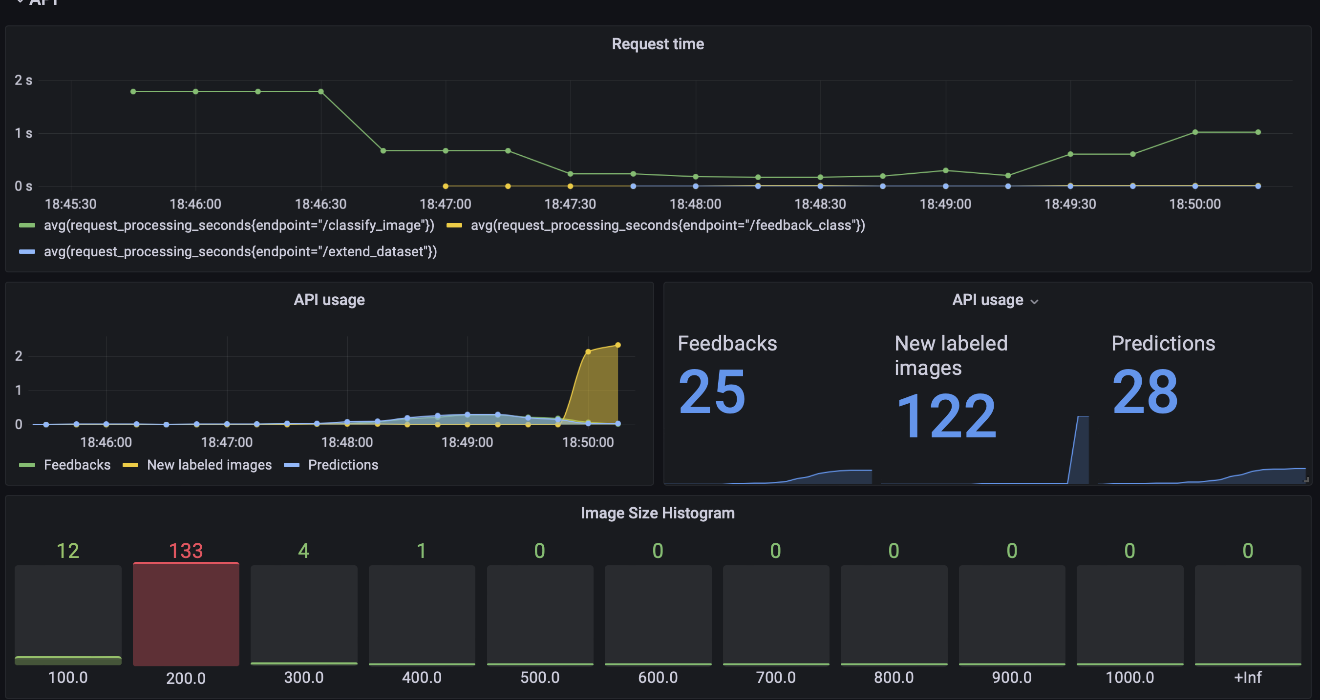
Grafana dashboard
API Usage

Slide 13
Prometheus Metrics
In order to monitor our system we decided to use:
prometheus_fastapi_instrumentator
A configurable and modular Prometheus Instrumentator for your FastAPI.
With this, your FastAPI is instrumented and metrics are ready to be scraped.
The defaults give you:
Counter http_requests_total
Counter process_cpu_second_total
Counter process_virtual_memory_bytes
from prometheus_fastapi_instrumentator import Instrumentator from prometheus_client import (
Counter,
Gauge,
Histogram,
)

Slide 14

Prometheus Metrics
Pulling strategy
The metrics are made available at /metrics endpoint using the Pull strategy
@app.on_event("startup")
async def startup():
Instrumentator().instrument(app).expose(app)
Pull from endpoint /metrics

Slide 15
Prometheus Metrics
Pulling strategy
# HELP img_size Histogram for tracking the size of the images
# TYPE img_size histogram
img_size_bucket{le="100.0"} 10882.0
img_size_count 10882.0
img_size_sum 39175.2
# HELP counter_predictions_total Counter for predictions that have been made
# TYPE counter_predictions_total counter
counter_predictions_total 10882.0
# HELP http_requests_total Total number of requests by method, status and handler.
# TYPE http_requests_total counter
http_requests_total{handler="/metrics",method="GET",status="2xx"} 127.0 http_requests_total{handler="/docs",method="GET",status="2xx"} 13.0 http_requests_total{handler="none",method="GET",status="4xx"} 4.0 http_requests_total{handler="/classify_image/",method="POST",status="2xx"} 874.0 http_requests_total{handler="/classify_image/",method="POST",status="4xx"} 87.0

Slide 16
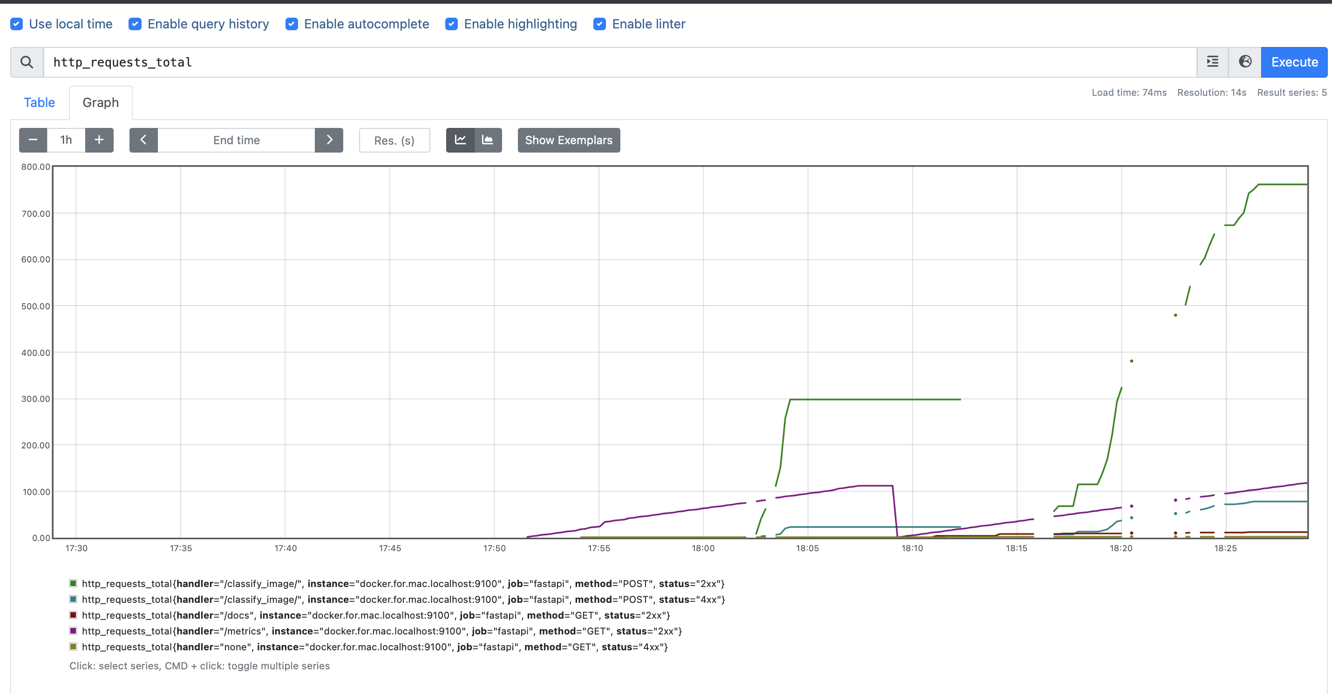
Prometheus Metrics
Pulling strategy

Slide 17
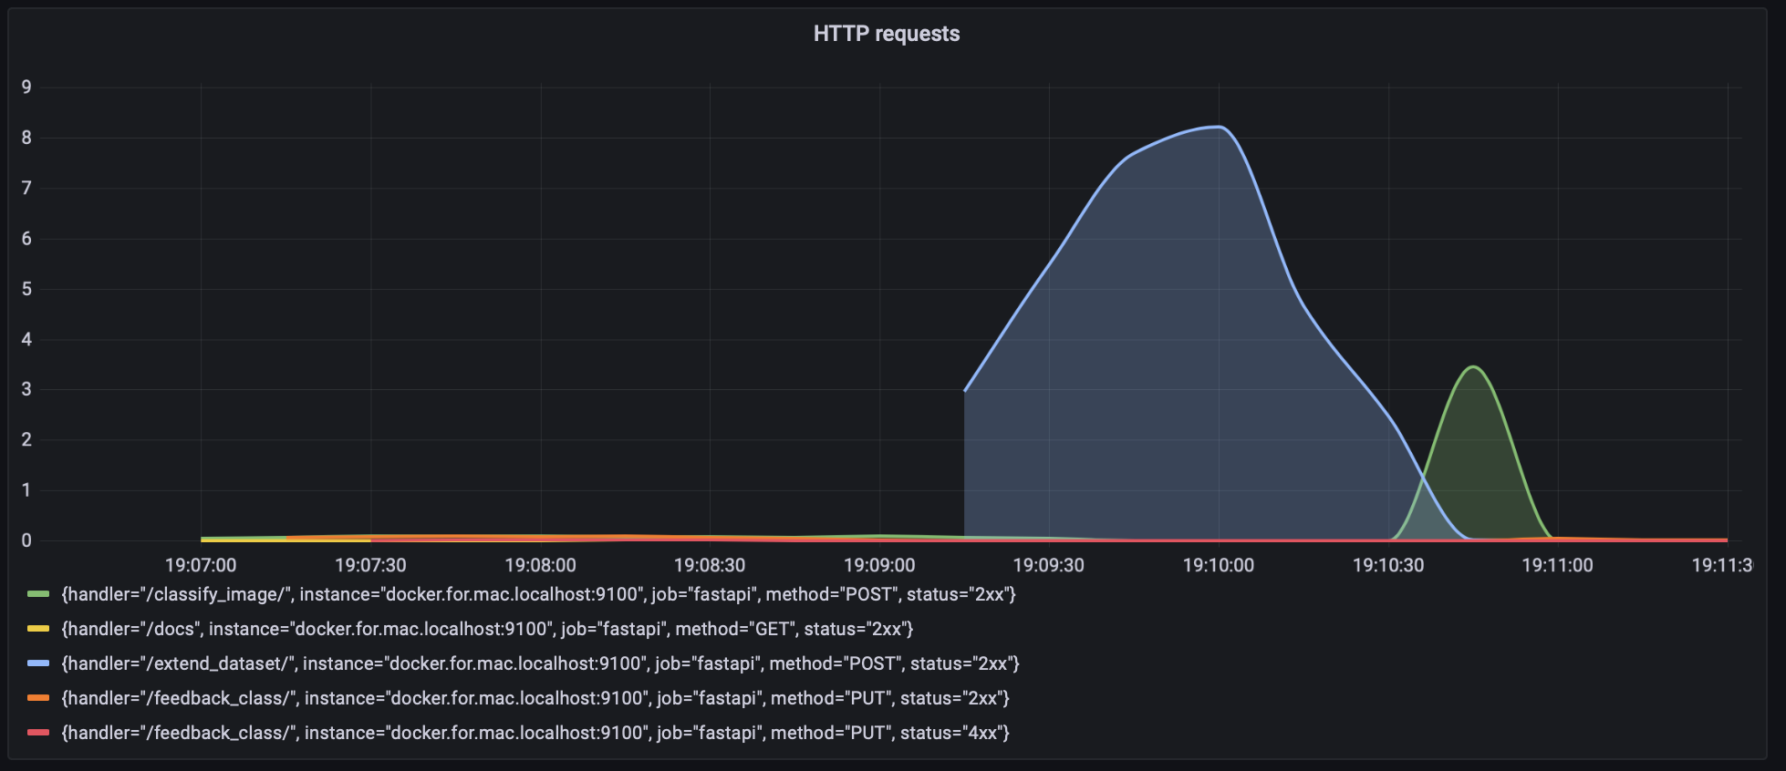
Grafana dashboard
PromQL queries for data visualization
rate(http_requests_total{handler!="/metrics", method!="OPTIONS"}[1m])

Slide 18
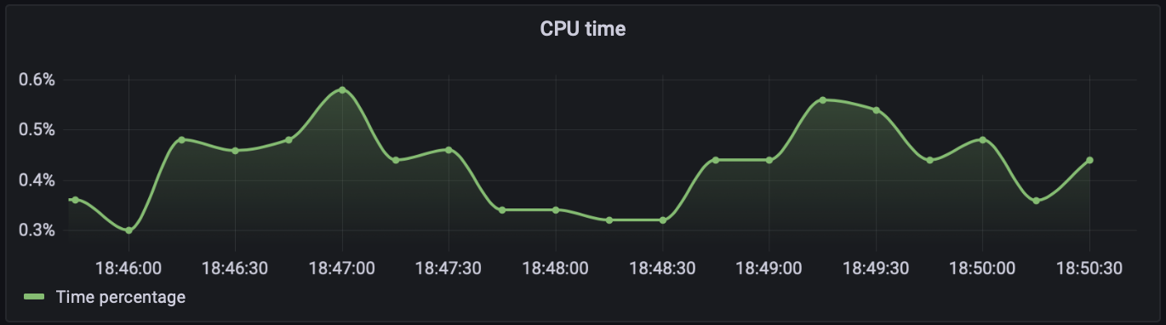
Grafana dashboard
PromQL queries for data visualization
rate(process_cpu_seconds_total{job="fastapi"}[1m])

Slide 19
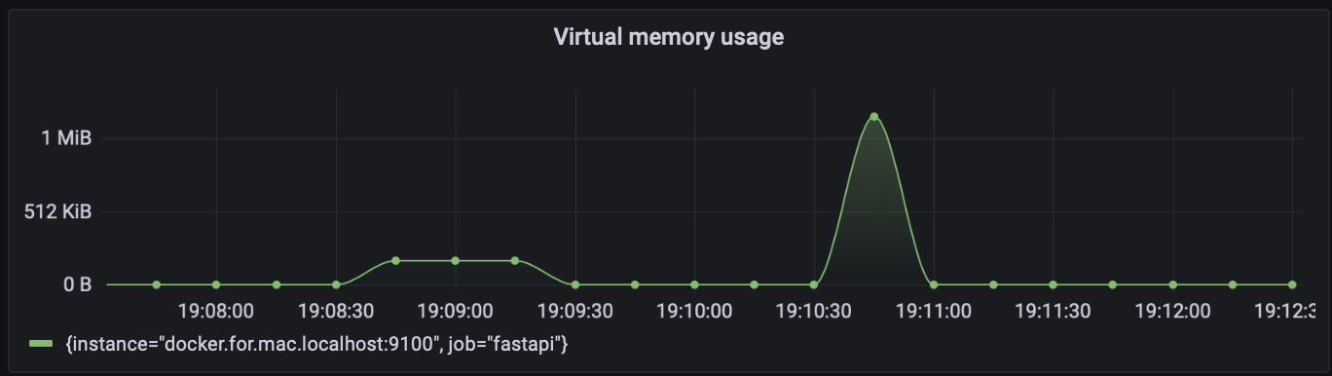
Grafana dashboard
PromQL queries for data visualization
rate(process_virtual_memory_bytes{instance="docker.for.mac.localhost:9100"}[1m])

Slide 20
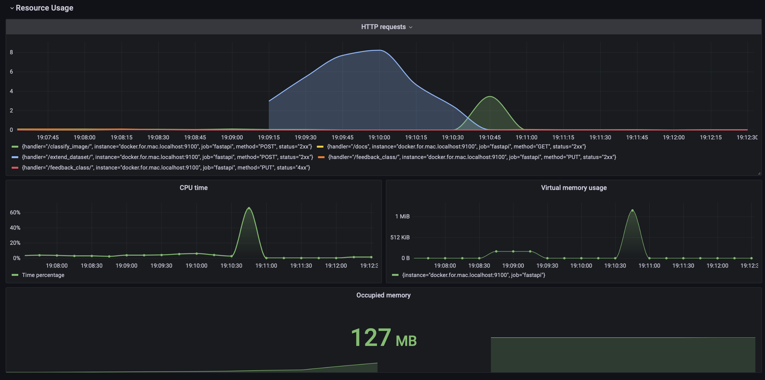
Grafana dashboard
Resource Usage

Slide 21
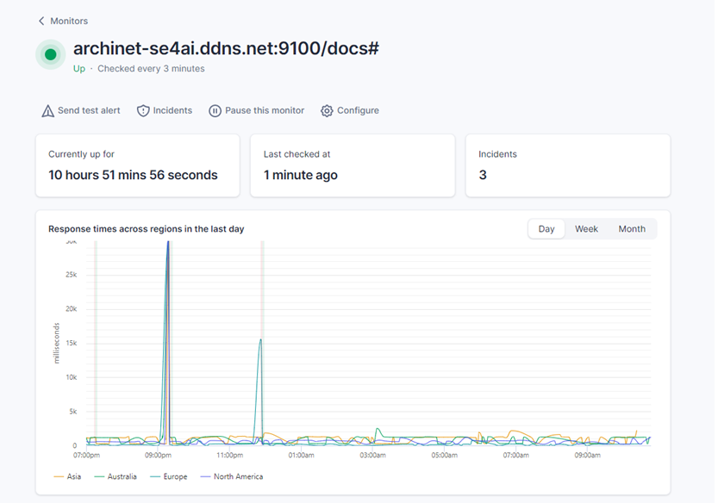
Better Uptime
Monitor System Availability: Backend

Slide 22
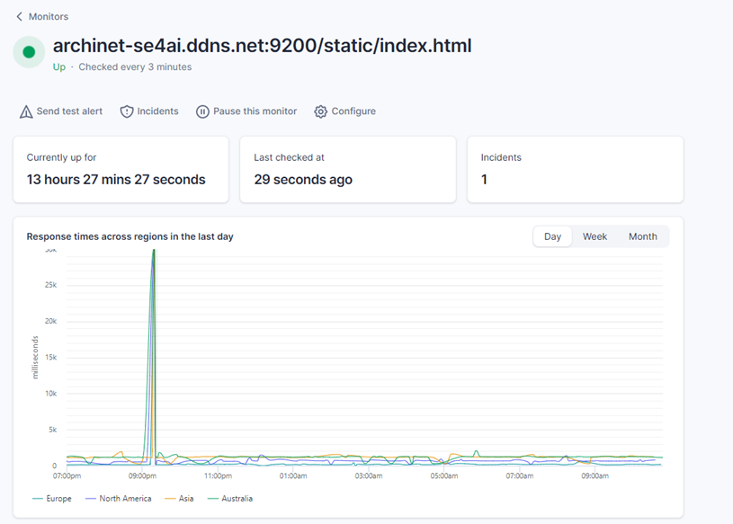
Better Uptime
Monitor System Availability: Frontend

Slide 23
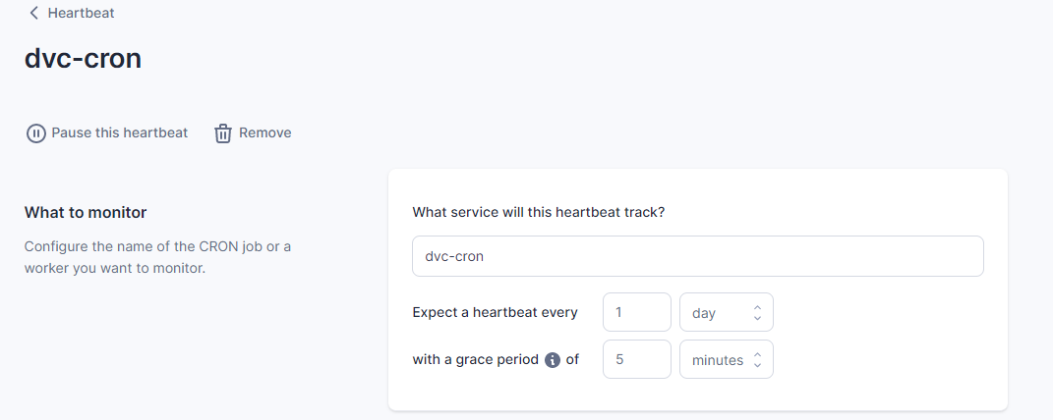
Better Uptime
Monitor Job Operativity: «Heartbeat»

Slide 24
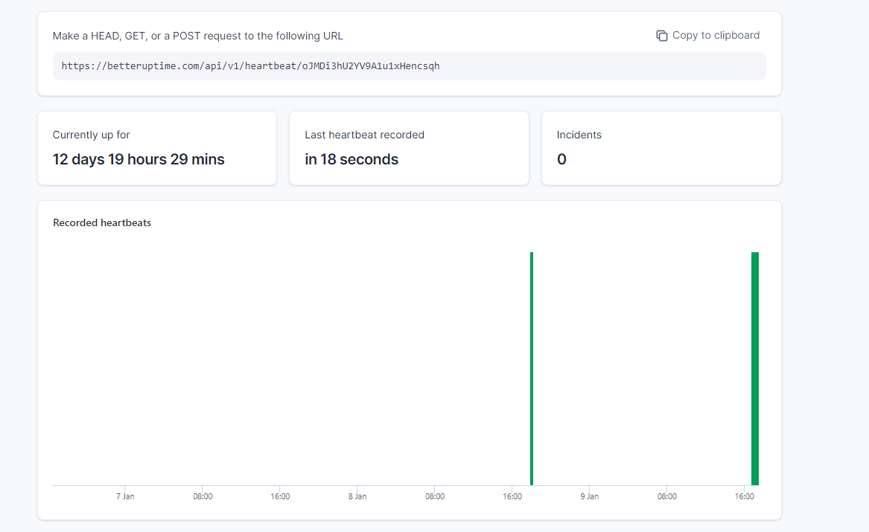
Better Uptime
Monitor Job Operativity: «Heartbeat»

Slide 25
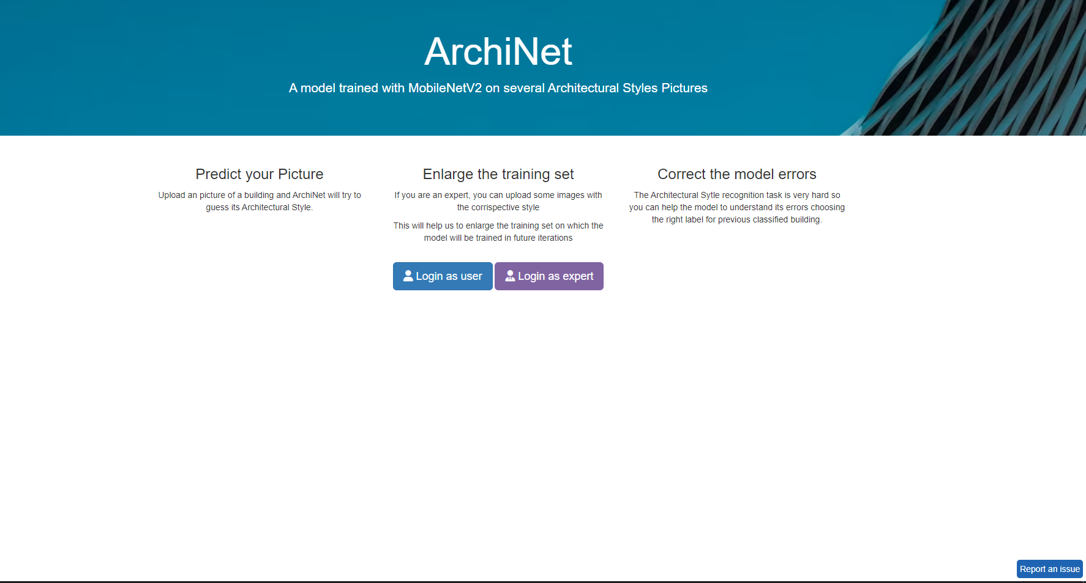
Better Uptime
Allowing user to report problems: «Incident Form»

Slide 26
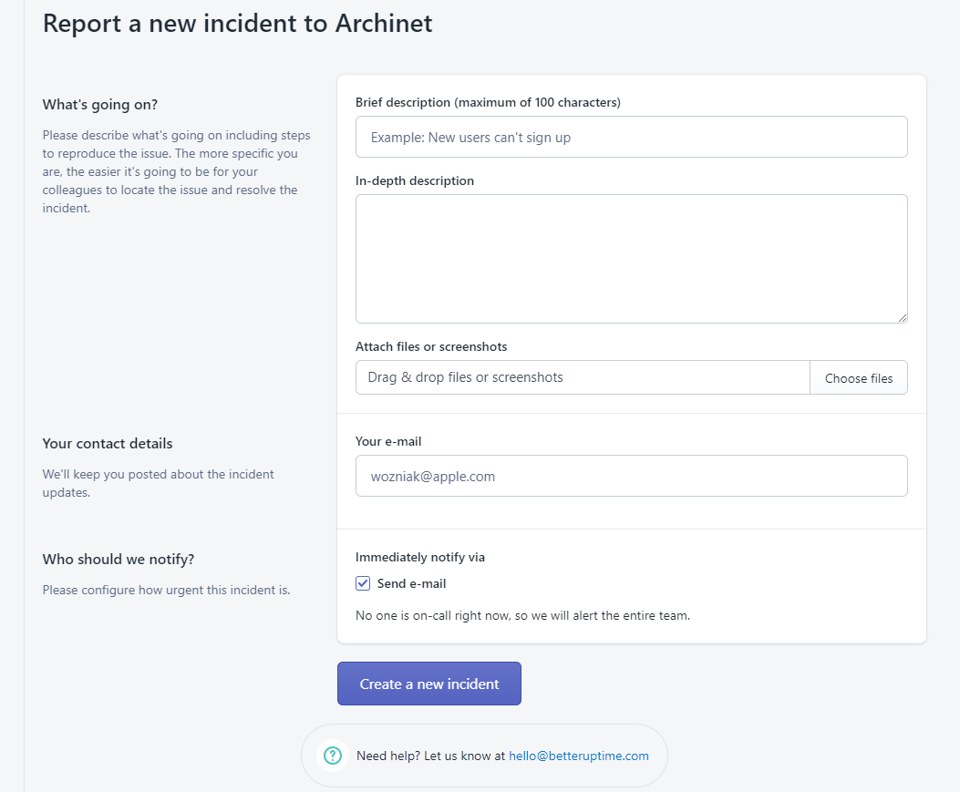
Better Uptime
Allowing user to report problems: «Incident Form»

Slide 27
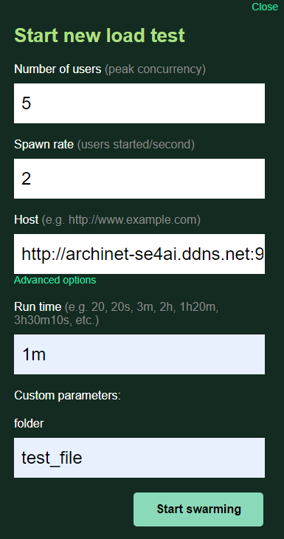
Locust
System load testing: a good case

Slide 28
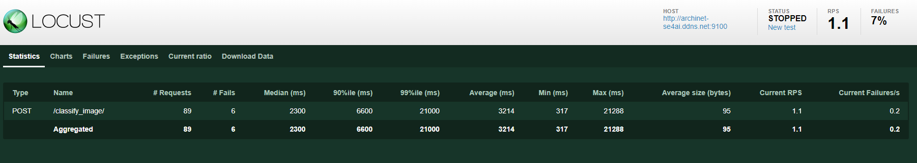
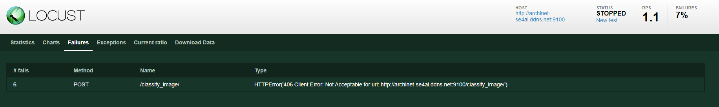
Locust
System load testing: a good case

Slide 29
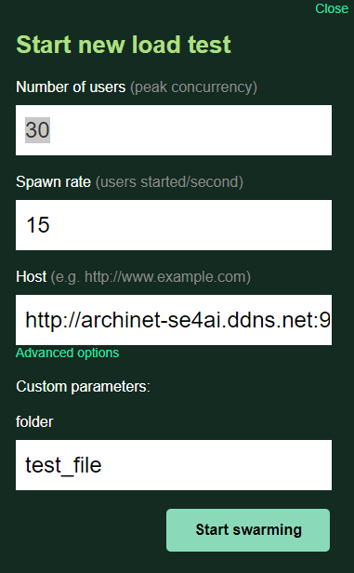
Locust
System load testing: a bad case

Slide 30
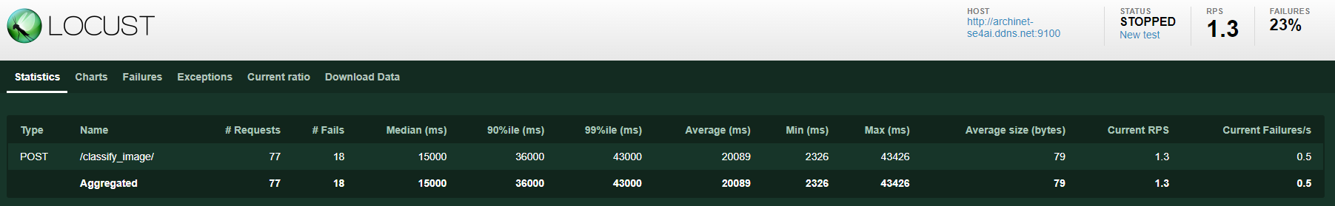
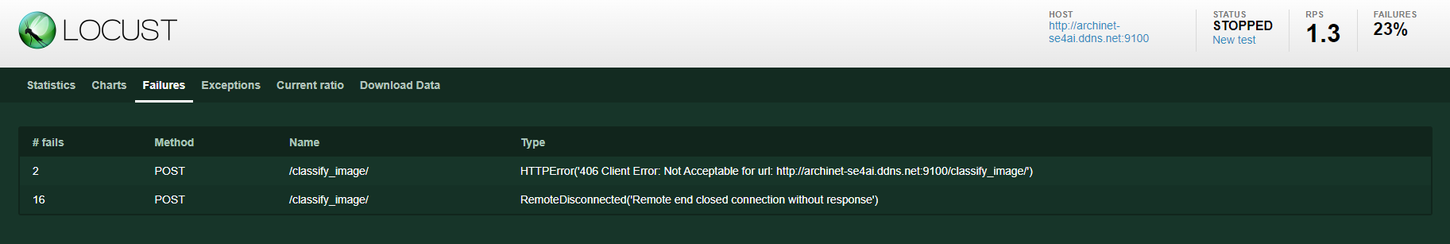
Locust
System load testing: a bad case

Slide 31

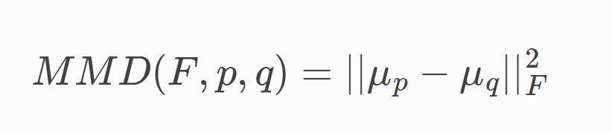
Alibi Detect
Data Drift Detection
In order to recognize Data Drift, a real problem for system that works on thing that change in time and space as architectural styles, the library Alibi Detect has been chosen.
In order to analyze this phenomenon while it’s happening, an online drift detector is used, in particular the Online Maximum Mean Discrepancy.
An Hilbert space F
Mean embedding of p
Mean embedding of q
The reference set is mapped onto the space F training an auto-encoder and taking only the econder.

Slide 32
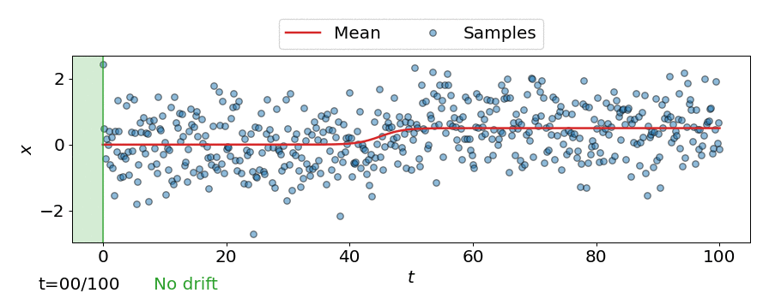
Alibi Detect
What is «Online Drift Detection»?
Online detectors operate on single data points at a time, rather than batches
These data points are passed into a "test-window" and compared to the reference data using a two-sample test-statistic (squared MMD)
If the test-statistic exceeds a preconfigured threshold, drift is detected
Configuration of the thresholds requires specification of the expected run-time and test-window size.

Slide 33
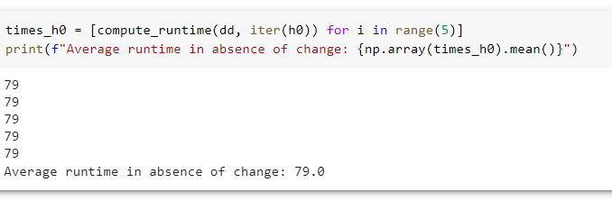
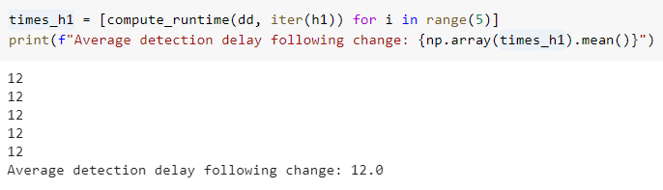
Alibi Detect
Experiments ad implementation
The drift detector has been trained using:
ERT = 50 # expected run-time in absence of change
W = 10 # size of test window
Drift Detector running on a sample of images taken from the same distribution of the reference set.
Drift Detector running on a sample of images taken from different distrubution including other architectural styles
After this experiments the drift detector has been included in the project and the average detection delay following change (avg_ddfc) monitored using Prometheus and Grafana.

Slide 34
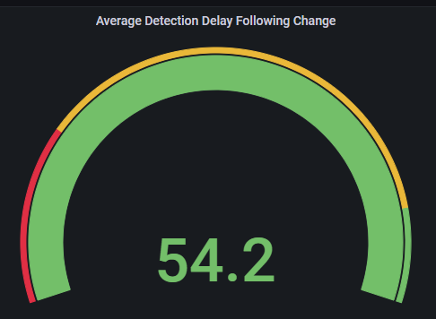
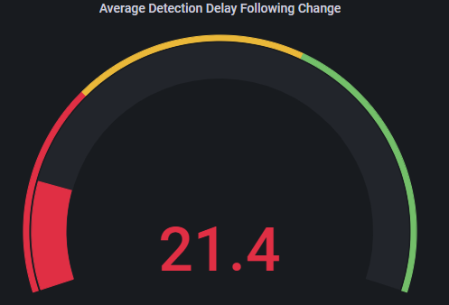
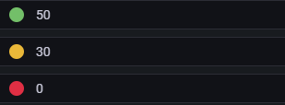
Alibi Detect
Experiments ad implementation
Over 50 we are almost sure there is no data drift.
Between 30 and 49 there is a slight decrerase that can be related to a data drift.
Under 30 is really probable that a data drift is going on.

Slide 35
Thank you!

